Slide 1
DermaTrack: Multispectral Imaging for Skin Diagnosis
by
Dr. Subhankar Mishra,
School of Computational Sciences
NISER, Bhubaneswar
Theme: Medtech devices for early detection and point of care
TRL Level: 4

Slide 2
Problem Statement
• Skin Infections are Frequently Misdiagnosed in Primary Care—--------------------------------- • General practitioners often rely on unaided visual inspection • This leads to misdiagnosis, delayed treatment, or overlooked conditions • Antibiotics are commonly prescribed for fungal infections, worsening patient outcomes
• Dermatoscopy Remains Underutilized in Frontline Settings—------------------------------ • While effective, it requires specialized training for accurate interpretation • Devices are expensive, contact-based, and often unavailable in smaller clinics • Workflow constraints further limit its adoption outside specialist care
• Overprescription Contributes to Rising Antimicrobial Resistance (AMR)________– • In the absence of diagnostic tools, broad-spectrum antibiotics are overused • AMR is accelerating due to unnecessary prescriptions in dermatological cases • Most of antibiotics for skin conditions are not clinically necessary

Slide 3
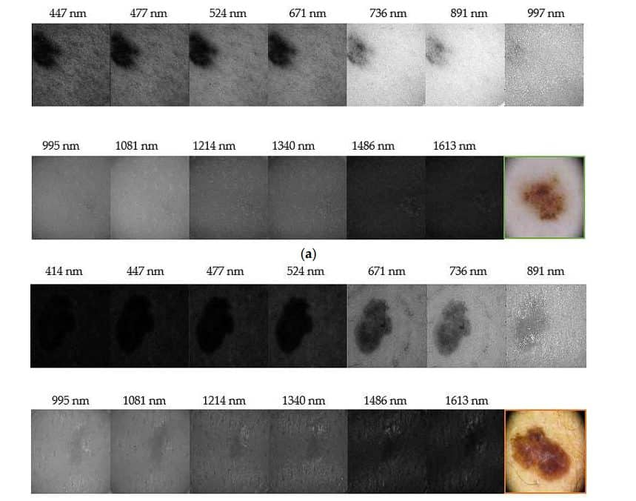
Solution
—-------Multisensor AI Diagnostic Platform—---
We propose a non-invasive, AI-driven diagnostic platform combining Multispectral Imaging (MSI) assisted with thermal sensing, humidity/TEWL monitoring, and skin gas (VOC) analysis. This multi-sensor system is designed for point-of-care use in frontline clinics, enabling objective, contactless assessment of skin and scalp conditions. By delivering real-time diagnostic insights through AI algorithms trained on curated clinical data, the system reduces misdiagnosis, avoids unnecessary antibiotic use, and eliminates reliance on specialist tools like dermatoscopes. Affordable, explainable, and easy to operate, it empowers general practitioners with a scalable alternative to traditional visual inspection, promoting timely care and reducing antimicrobial resistance.

Slide 4
USP/Differentiator
Feature | Our MSI Dermascope | Spectral AI (DeepView)
Cost | - Low-cost smartphone-based device (minimal hardware) – affordable for widespread use. | - High-cost advanced MSI device (developed with large R&D investments; license-based hospital model)[1].
Portability | - Ultra-portable: compact, phone-integrated attachment; easily usable in rural clinics. | - Handheld device: portable in clinics but requires proprietary hardware[3] (SnapShot M version in development for field use).
AI Scope | - Broad AI analysis: can identify multiple skin conditions (e.g. infections, ulcers) and assess wound status for diverse cases. | - Focused AI: predicts wound-healing outcomes (e.g. burn depth healing, diabetic foot ulcer risk) using MSI[5].
Feature | Our MSI Dermascope | Spectral AI (DeepView)
Spectral Range | - Multispectral bands: uses selected visible and near-IR wavelengths (with optional UV fluorescence for detecting pathogens). | - Wide spectrum: captures from visible blue light to deep infrared reflectance[6] for tissue health assessment.
Ease of Deployment | - Easy deployment: plug-and-play via smartphone app; minimal training. Field-friendly for on-site use (suitable for PHCs/remote areas)[7]. | - Specialized setup: requires dedicated device & training; currently in clinical trials and regulatory approval phases (limited availability)[8].
Diagnostic Breadth | - Multi-purpose: evaluates a wide range of skin issues (tracks wound size, detects infection and pathogen type)[10], and can aid general dermatology exams. | - Narrow scope: tailored to chronic wound assessment – gauges tissue viability and healing potential for burns/ulcers[11] (not used for other dermatological conditions).

Slide 5
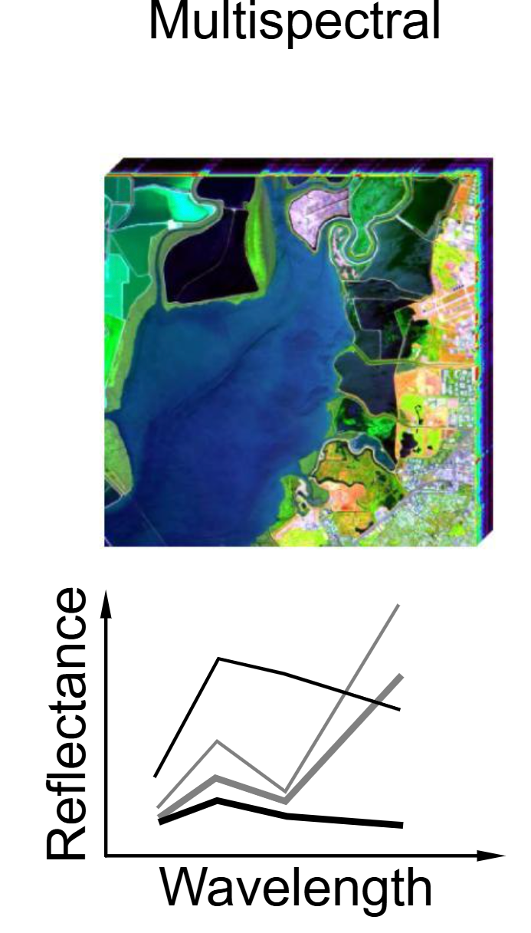
Impact
Portable, non-contact MSI sensors enable frontline adoption of dermatoscopy in small clinics
Immediate impact on diagnostic accuracy once deployed.
Achieve ≥90% accuracy in infection differentiation using a calibrated multispectral imaging system and cloud based processing algorithms.
Significant reduction in misdiagnosis of infection and AMR at early stage using our AI-Enhanced diagnosis model.
The AI-Enhanced Diagnostic Model will significantly accelerate the diagnostic process, reducing evaluation time by a substantial margin and enabling quicker, more efficient clinical decision-making.

Slide 6
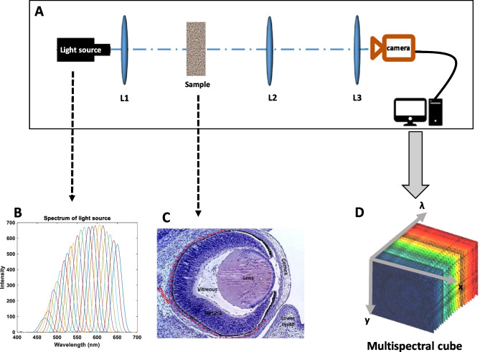
Project Plan/Methodology
Prototype Development: Build hardware using Multispectral Imaging (MSI) and complementary sensors (e.g., thermal, TEWL, gas/VOC).
Data Acquisition: Capture stacked images across wavelengths to form MSI cubes; collect parallel sensor data.
Dataset Creation: Collaborate with clinical experts for annotation and dataset curation.
Model Development: Train ML models to identify patterns, classify conditions, and provide diagnostic output.
Application Integration: Develop a clinician-facing app integrated with the trained model for real-time use.
Validation & Deployment: Pilot the system in a clinical setting for performance validation.
Certification & Scale-Up: Pursue regulatory certifications and licensing based on validation outcomes.

Slide 7
Milestones
 | Milestone Details | Time Period Required from To ( To Being Project Start Date)
Milestone 1: | Literature review, clinical gap identification, stakeholder consultation, Prototype designing, MSI device concept design and wavelength band selection (Optical simulation, component selection, lighting/sensor strategy) | T0 - T0+3 months
Milestone 2: | Final product designing, Hardware-software integration and internal testing (Functional device with MSI + AI + app pipeline; testing with synthetic data) | T0+3 - T0+9 months
Milestone 3: | Dataset collection and MSI data acquisition (collecting data for training the model), Model development and validation (Train CNN for classification of wounds, infections, rashes, other skin issues), App and backend development (Integrating with the model and developing a software) | T0+9 - T0+15 months
Milestone 4: | Field testing (Validate accuracy, usability with doctors and health workers), Regulatory alignment, certification preparation,Final documentation, project report and pitch materials (Hand-off, tech transfer, research publication and investor readiness) | T0+15 - T0+18

Slide 8
Skin Diagnostic Market
01
Global Market
Robust growth trend: The global skin diagnostics market is expanding steadily (projected high single-digit ~10% CAGR)[12], driven by rising skin disorder prevalence and demand for early, accurate detection.
Key drivers: AI, hyperspectral imaging, and telehealth drive growth, with rising skin health awareness boosting advanced diagnostic tool use.
Opportunity zones: AI-powered devices and teledermatology extend skin diagnostics beyond hospitals to clinics, wound care centers, and telemedicine networks worldwide.
02
Indian Market
High growth potential: India’s skin diagnostics/teledermatology sector is surging with a projected double-digit CAGR (~12%) over the next decade[16]. Growth is fueled by a vast patient base and expanding healthcare access.
Demand drivers: Approximately 30% of Indians suffer from some skin ailment[17], but rural areas lack dermatologists. However, digital health initiatives and better telecom are boosting teledermatology, improving remote skin care access.
Major opportunities: Deploying affordable, innovative diagnostic tools across dermatology clinics, urban hospitals, PHCs, and district hospitals, with telemedicine scaling to improve specialist and remote skin care access in India.

Slide 9
Resources & Budget
Sr. No | Item | 1st Year | 2nd Year | Total
1 | Manpower | 1,200,000 | 480,000 | 1,680,000
2 | Equipment | 1,400,000 | 100,000 | 1,500,000
3 | Consumables | 100,000 | 10,000 | 110,000
4 | Travel | 20,000 | 20,000 | 40,000
5 | Miscellaneous | 70,000 | 30,000 | 100,000
6 | Contingency | 50,000 | 50,000 | 100,000
7 | Overhead | 568,000 | 138,000 | 706,000

Slide 10
Funding So Far
No external funding has been raised through other entities for this project.

Slide 11
Team
Project Investigator:
Dr. Subhankar Mishra, Faculty, School of Computer Sciences, NISER Bhubaneswar
Members:
Subhra Jyoti Mishra, School of Physical Sciences, NISER Bhubaneswar
Mohammad Haris, School of Physical Sciences, NISER Bhubaneswar
Meet Kamleshbhai Bhatt, School of Physical Sciences, NISER Bhubaneswar
Soumya Mishra, School of Physical Sciences, NISER Bhubaneswar
Roddur Das, School of Physical Sciences, NISER Bhubaneswar

Slide 12
Conclusion
Our Multisensor AI Diagnostic Platform addresses key clinical gaps empowering frontline providers with objective, rapid, and accurate skin diagnostics that go far beyond traditional visual inspection.
The solution is ultra-portable, affordable, and specifically designed for deployment in diverse care settings from rural clinics and Primary Health Centers to telemedicine platforms and specialist hospitals.
By reducing misdiagnosis, minimizing unnecessary antibiotic use, and providing actionable, explainable insights, we can significantly improve patient care and combat rising antimicrobial resistance globally.
With robust AI-powered analysis, seamless workflow integration, and focus on usability, our platform is poised to capture high-growth opportunities in the global and Indian skin diagnostics markets.
With a clear project roadmap and milestones, partnering with healthcare stakeholders we look forward to revolutionize point-of-care skin diagnostics and promote healthier communities.

Slide 13


